Slide 1
Operating Systems
Chapter 3 (b)
Process Management
Hammad Afzal
hammad.afzal@mcs.edu.pk
Department of Computer Software Engineering
National University of Sciences and Technology

Slide 2
Roadmap
Operations on Processes
Creation of Process
Termination of Process

Slide 3
Process Creation
Parent process create children processes, which, in turn create other processes, forming a tree of processes
Create-Process System Call
Creating process is called parent process.
Created processes are called children of the process
Generally, process identified and managed via a process identifier (pid)

Slide 4
Process Creation
Resource sharing
Three possibilities
Parent and children share all resources OR
Children share subset of parent’s resources OR
Parent and child share no resources
Execution
Two possibilities
Parent and children execute concurrently OR
Parent waits until children terminate

Slide 5
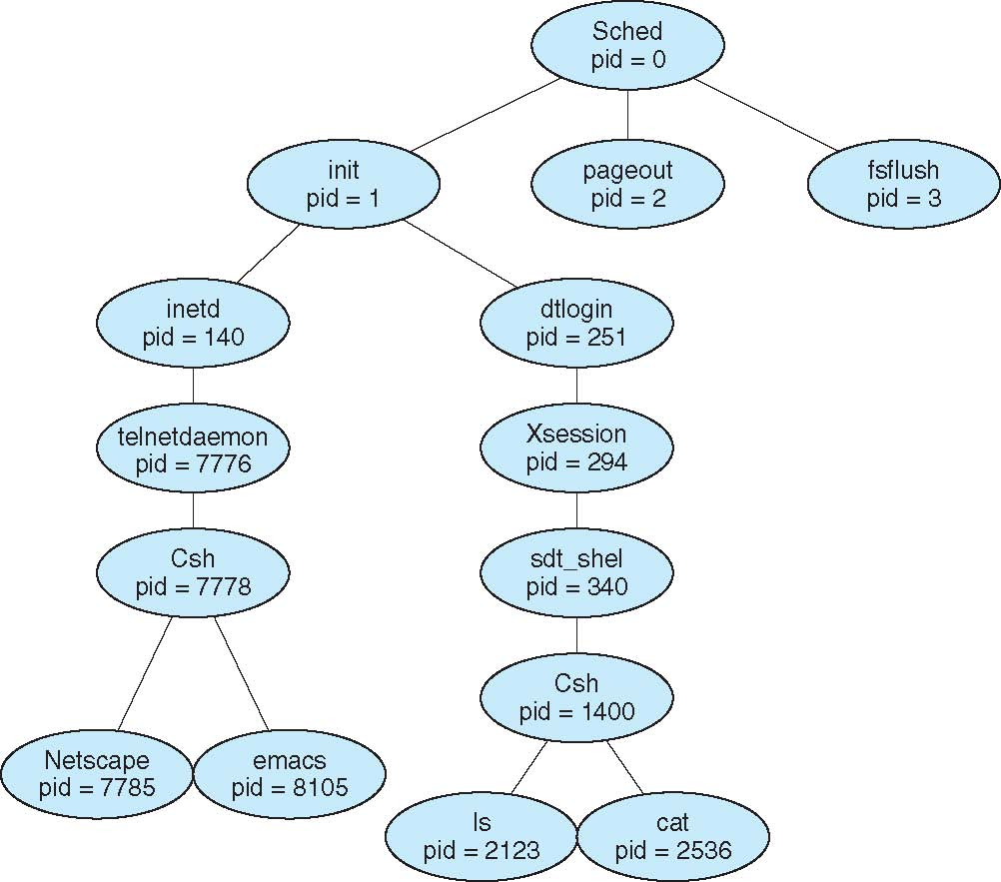
A Tree of Processes on Solaris

Slide 6
Process Creation (Cont.)
Resource Sharing
Execution
Process needs resources (CPU time, memory, files, I/O devices). Sub-process may
obtain resources from OS. OR
Obtain subset of resources of parent process. OR
Parent may partition resources or share them among children (e.g. memory, files). AND
Initializing data may also be passed to child process.
When process creates a new process, two possibilities
Parent continues to execute concurrently with children
Parent waits until some or all children terminate

Slide 7
Process Creation (Cont.)
Address space
Child duplicate of parent (same program and data as parent)
Child has a program loaded into it
UNIX examples
fork system call creates new process.
New process consists of a copy of address space of original process.
Both processes continue execution after fork():
The return code for fork() is zero for new process (child) and process identifier (of child) for parent process.
Programming: Try this at home or lab or anywhere

Slide 8
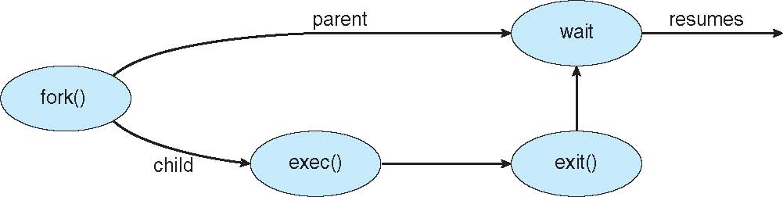
Process Creation (Cont.)
exec system call used by one of two processes after a fork to replace the process’ memory space with a new program
Execute loads binary file into memory (destroying the memory image of program containing exec() and starts its execution.
Parent process either continues or creates new children or waits for termination of child (using wait() system call)

Slide 9
Process Termination
Process executes last statement and asks the operating system to delete it (exit() system call)
Output data from child to parent (via wait system call)
Process’ resources are de-allocated by operating system
Process may terminate other process using appropriate system call
Usually only parent may terminate execution of children processes (abort)
Parent needs to know the identity of children.
Programming: Try this at home or lab or anywhere

Slide 10
Process Termination
The termination can be invoked due to many reasons such as:
Child has exceeded allocated resources (parent must have a mechanism to inspect the state of children).
Task assigned to child is no longer required.
Parent is exiting and OS does not allow child to continue if its parent terminates
All children terminate with parent - cascading termination
Unix, parent process is informed with wait() system call about termination of child process.
Wait returns the process id of child
If parent terminates, all children processes are assigned init() as parent process

Slide 11
Some Code Snippets Not included in Theory Exam

Slide 12
C Program Forking Separate Process
#include <sys/types.h>
#include <studio.h>
#include <unistd.h>
int main()
{
pid_t pid;
/* fork another process */
pid = fork();
if (pid < 0) { /* error occurred */
fprintf (stderr, "Fork Failed");
return 1;
}
else if (pid == 0) { /* child process */
execlp("/bin/ls", "ls", NULL);
}
else { /* parent process */
/* parent will wait for the child */
wait (NULL);
printf ("Child Complete");
}
return 0;
}

